Slide 1

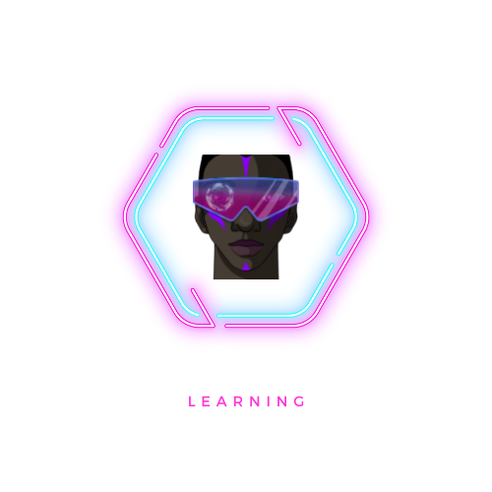

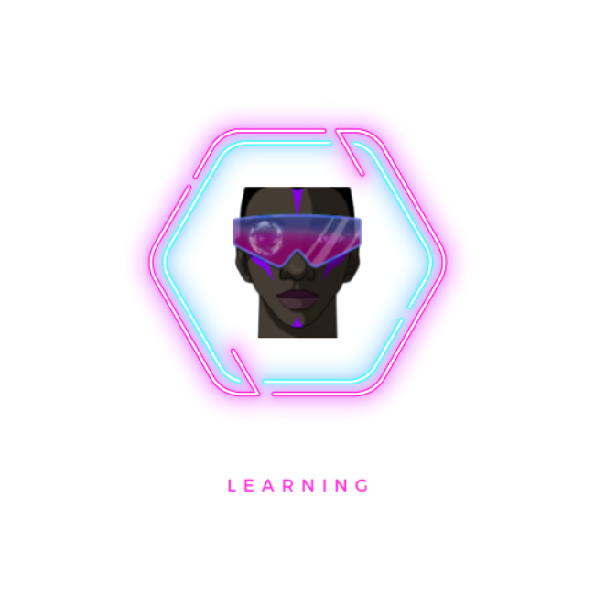
Project CyberX
Victoria Hektor
Notes:
Welcome to my presentation on my final year project, Cyberx.

Slide 2
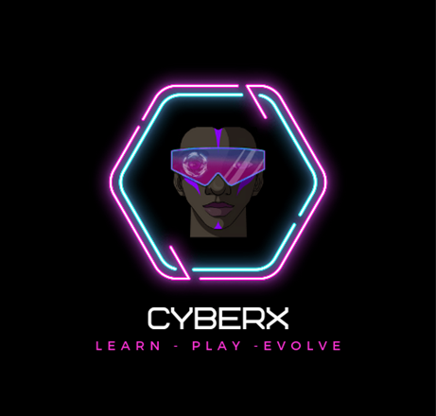
Agenda
Presentation
Demonstration
Questions
Notes:
I will be talking through my experiences on this journey then we will move on to the demonstration, and there will be time at the end for any questions.

Slide 3

The Problem
Gender Disparity
Under-representation
Pay Gap
A report by TechUK found that just 26% of the tech workforce are women, not only that, this gender divide is even larger when looking at more technical roles.
A discovery by Tech Nation showed that 77% of Director roles were filled by men, Women In Tech reported the findings and noted that this under-representation was much worse when taking ethnicity into account and gender.
Women In Tech found that there is a 16% gender pay gap in the UK compared to the national average of 11% across all industries.
Age is a factor
Gender Comparison
Self belief
This gender gap is prevalent from a young age with only 19% of CompSci, Engineering & Technology students identifying as female.
TechUK also found that at school age, 35% of boys compared to 22% of girls took two or more A Levels in a STEM Subject.
SDG Monitor reported on this particular subject, a recent study by UNESCO (2019) found that girls excelled better than boys when measuring computer skills tasks, but showed a lower level of confidence and perception of ones own skills.
Notes:
This project idea was born out of a need to address a huge problem in the world of tech, gender disparity. (Talk through points*)

Slide 4
Solution
Close the gender & pay gap by:
Our Target audience:
Engage more young girls+ in early education
Provide mindful & confidence lessons from a young age
Building Diversity & Culture within businesses
Have transparency across all areas of business, from salary to working hours
11-17 years old
13+ for the Inspector Digi task (this involves engagement with social media platforms)
Disadvantaged girls+ (I would hope in the future to provide outreach for this)
Effective Workforce practices:
Engage at a young age
Workplace flexibility
Showcase diversity, and mean it
Provide training on gender disparity in tech to workforces
Encourage more young girls+ from a young age to engage with tech-based learning
Offer confidence building classes to enable a better self-belief among girls+
Notes:
Discuss the available solutions to this problem. This is a deep rooted problem that won’t go away with just a little support and encouragement, this is an issue that must be hit at the core of its problem.

Slide 5
Similar Providers
Girl-Code
Stemettes
Girls Who Code
Girls In Tech
Microsoft DigiGirlz
CybHER

Slide 6




What I have learned
Frontend Development
Secure Web Application
Testing
Self belief
Because of this project, I am a better frontend developer, I have created a full demo of my application using frontend only, and I never thought I’d complete it.
Although not everything worked, I have learned to develop small parts of my application separately and they work! I had no confidence in the beginning but now I want to learn more.
I hadn’t completed testing of applications in a full capacity and had little knowledge, I succeeded in testing the working parts of my application.
Throughout my 3 years here at DMU, I have struggled with self-confidence and belief, and had massive imposter syndrome, this project has gone some way to alleviate some of my fears, not all but some! I am feeling better placed to champion women in tech.
Notes:
Discuss here the positives to come out of this project, (Don’t focus too much on negatives)

Slide 7

CyberX Demo
Notes:
Discuss the secure aspects of the working back end and the considerations.
Used prepared statements.
Didn’t manage to get a separation of concerns.
Has the admin dashboard functionality to add/delete courses and users.
Used PHPMyAdmin due to not being able to get the other way working.
I feel this project has shown me that I am not a coder, I would need much more experience to be capable of creating a big project like this in the future.

Slide 8

Future Research & Development
Research​
I would love to carry out in depth research about societies expectations of gender roles and how these impact girls+ decisions in education and work
CyberX​
I would love for this project to be realised fully and launched, I am considering reaching out to some really good programmers to potentially support getting this off the ground as this is the part that I most struggled with. Additionally I would love to create a grading system for schools based on their tech education delivery to young girls+
Outreach
Coming from a disadvantaged background myself, I understand the difficulties faced and would love to provide outreach to schools from disadvantaged areas to have a positive impact in young girls+ lives
Notes:
I feel that this project has made me realise that my passion lies in helping others, and challenging the disparity in this world. I may not have been an great programmer here but I learned so much and grew my confidence in areas that I thought I would never build it.

Slide 9

Summary
CyberX was born out of a desire to tackle the issue of gender disparity, right at the core of the problem, I may not have technically excelled in all areas, but the ones that I have excelled in, I am proud of.
Hopefully this is the first step towards me making this a more equal future for women+ and girls+ of all ages.

Slide 10
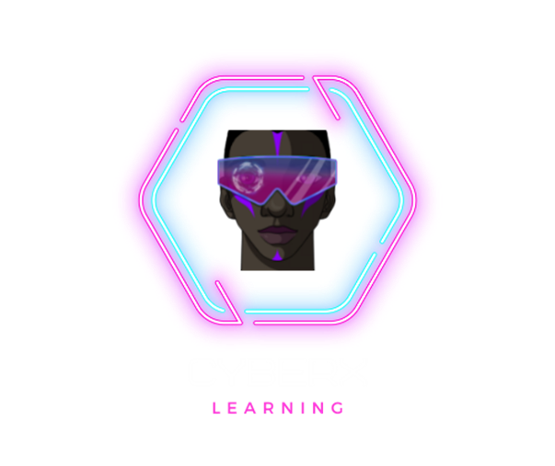
Thank you
Victoria Hektor
Presenting CyberX
p2629898

Slide 11
References
3,053 Robot And Human Hand Photos and Premium High Res Pictures - Getty Images [WWW Document], n.d. URL https://www.gettyimages.co.uk/photos/robot-and-human-hand (accessed 5.10.23).
8 facts about women in the Tech industry, 2023. . Women Technol. URL https://www.womenintech.co.uk/8-facts-women-tech-industry (accessed 5.10.23).
Bridging digital confidence gaps and empowering women in tech [WWW Document], 2021. . SDG Monit. URL https://www.sdgmonitor.co/post/bridging-digital-confidence-gaps-and-empowering-women-in-tech (accessed 5.10.23).
CybHER® : Women & Girls in Cyber Security & Information Technology [WWW Document], n.d. . CybHER. URL https://www.cybher.org/ (accessed 5.10.23).
DigiGirlz at Microsoft [WWW Document], n.d. . Microsoft. URL https://www.microsoft.com/en-us/diversity/programs/digigirlz/default.aspx (accessed 5.10.23).
GirlCode - Women-In-Tech Community & Technology Consultancy [WWW Document], n.d. URL https://www.girl-code.co.uk/ (accessed 5.10.23).
Homepage [WWW Document], n.d. . Girls Tech. URL https://girlsintech.org/ (accessed 5.10.23).
STEAM Is For All [WWW Document], n.d. . Stemettes ®. URL https://stemettes.org/ (accessed 5.10.23).
UK [WWW Document], n.d. . Girls Who Code. URL https://girlswhocode.com/en-uk (accessed 5.10.23).
Why is there a gender gap in tech and how to solve it? [WWW Document], 2023. . TechUK.org. URL https://www.techuk.org/resource/why-is-there-a-gender-gap-in-tech-and-how-to-solve-it.html (accessed 5.10.23).

